Slide 1
COMPUTER FUNDAMENTALS
A 1.2.4 Construct and analyse truth tables

Slide 2
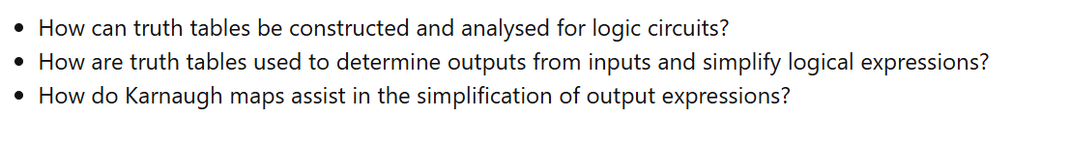
KEY Questions

Slide 3


success criteria
Lesson objective
To learn basic logic gates
To identify gates using different symbols
Create Truth Table
All should be able to define different logic gates
Some would be able to create truth tables using 2 and three inputs
Few would be able to apply logic gates for equations
ATL–
Collaboration, Critical thinking, Curiosity, Creativity, Communication, Confidence
HOT Question – Higher Order Thinking
Applications in Real Life

Slide 4
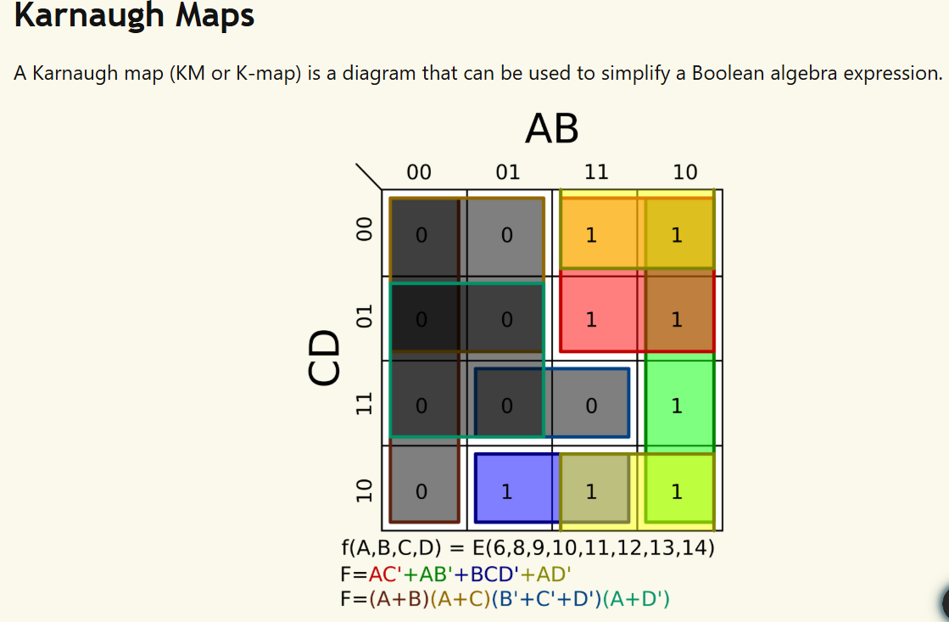

Slide 5
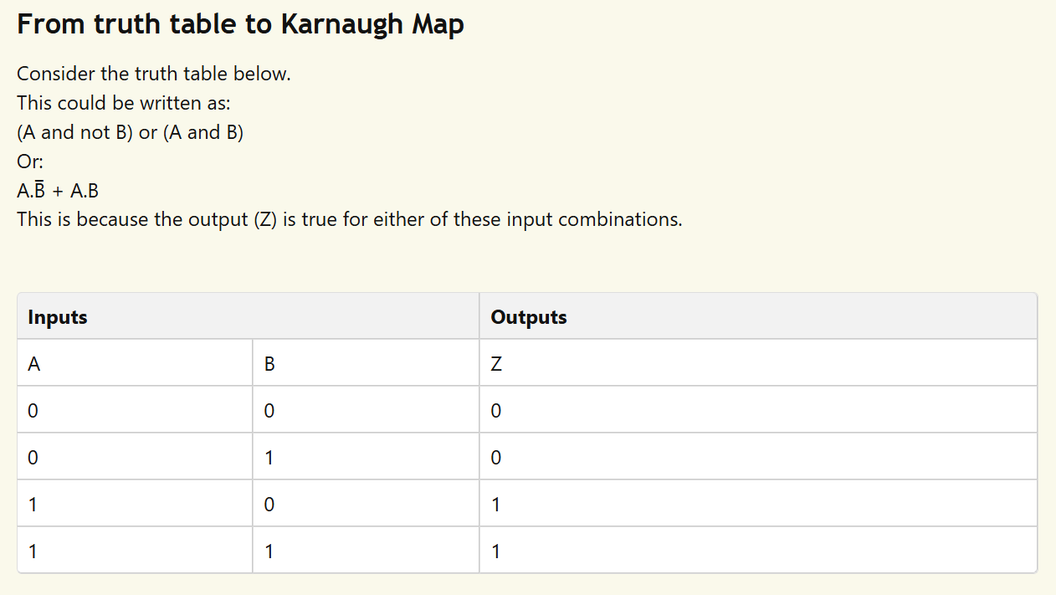

Slide 6
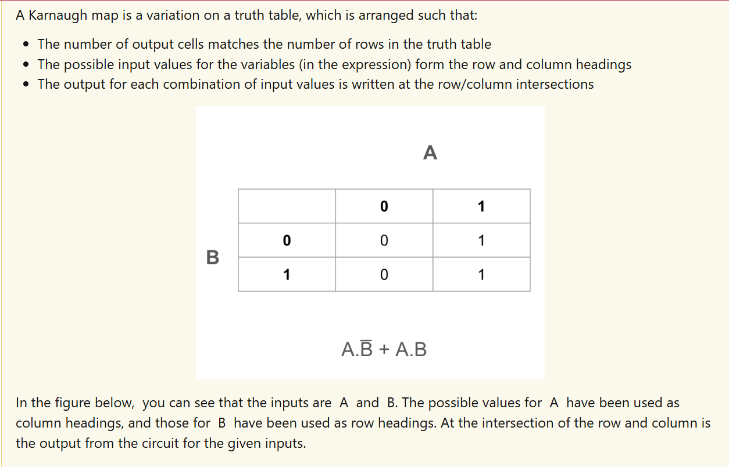

Slide 7
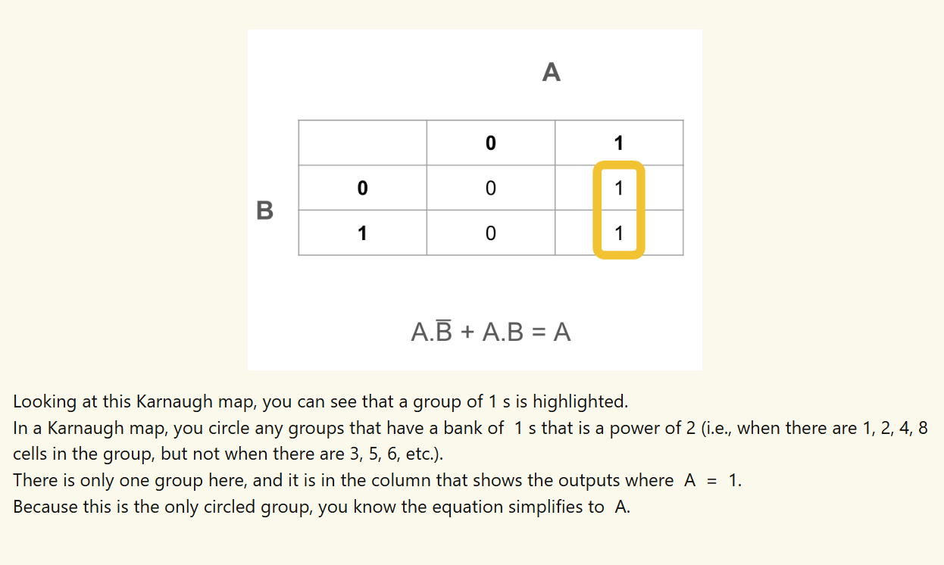

Slide 8
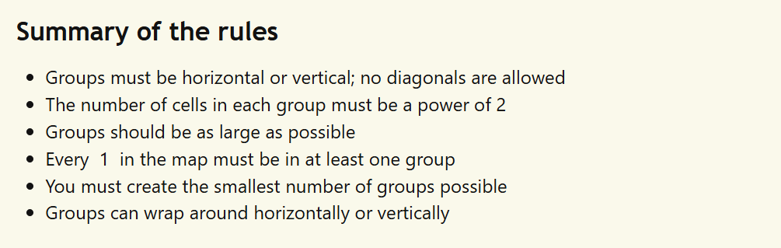

Slide 9
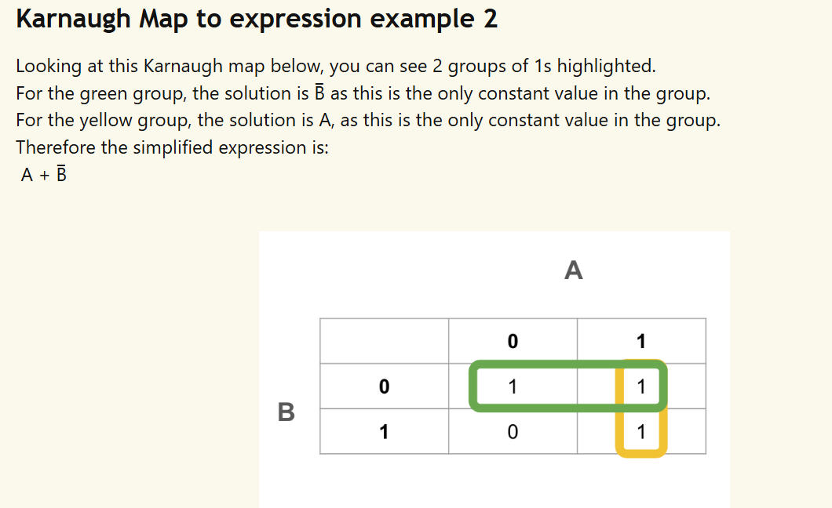

Slide 10
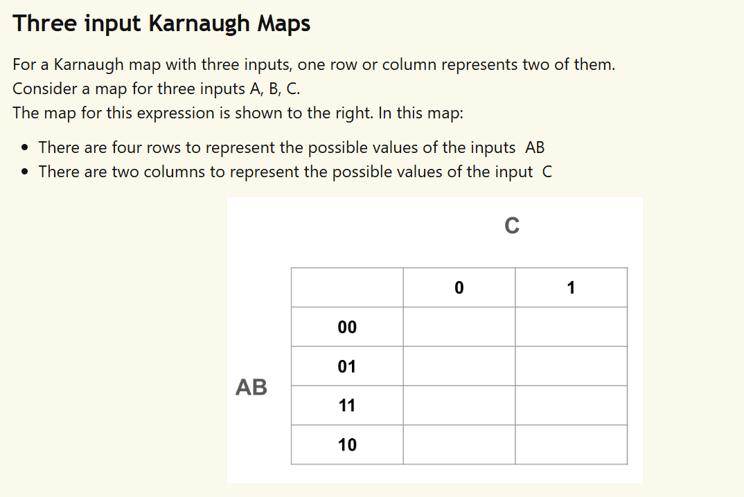

Slide 11
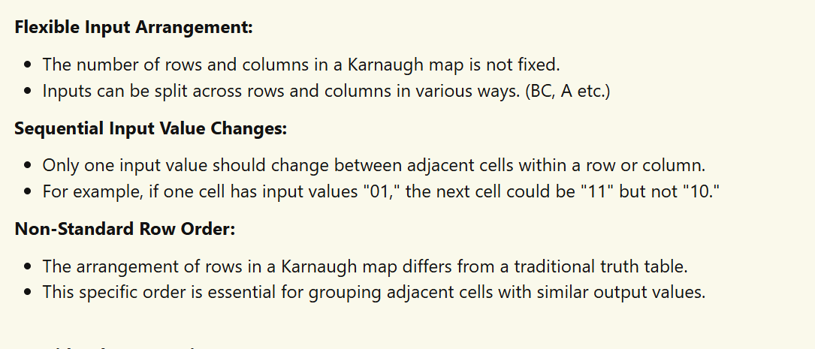

Slide 12
